Slide 1
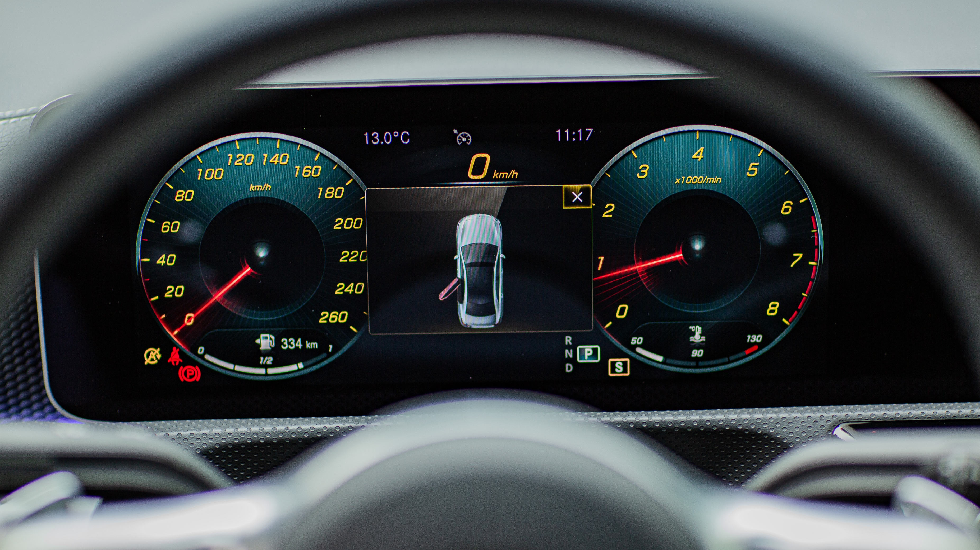
Detection of blind spot
VISION GUARD
A Low-Cost Solution for Safer Overtaking
Institute: KIET
Date: May 17, 2025

Slide 2





Team Members
11696 Muhammad Abad Khan
E-mail: abadkhan5438@gmail.com
Expertise: Cyber Security, Networking, UI/UX
11965 Sadia Naz
E-mail: sadiaarif.khan05@gmail.com
Expertise: Cyber Security, Artificial Intelligence, Database
13619 Tooba Anwer
E-mail: toobaanwer32@gmail.com
Expertise: Front-end Development Using Html CSS JavaScript
64822 Warisha Jamal
E-mail: warishajamalsai@gmail.com
Expertise: Python Developer, Artificial Intelligence

Slide 3
1
Introduction
6
Tools & Technology
2
Problem Statement
7
Similar Applications
Table of contents
3
Motivation
8
Project Features
CONTENTS
4
Proposed Solution
9
Testing & Validation
5
Project Objective
10
Work Flow
11
Conclusion

Slide 4
01
Introduction

Slide 5
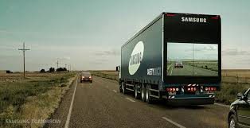
Introduction
The goal of a Vision Guard is a smart safety system designed to reduce road accidents caused by blind spots on overtaking scenarios. It helps drivers to make safer decisions for overtaking by detecting too close vehicles, estimating their speed, and showing real time alerts on a screen. The system uses a camera (ESP32-CAM), microcontroller (Arduino Uno), and LCD screen to display front view of the truck. It also includes LED indicators for overtaking logic and stores driving history on a web dashboard. Vision Guard is built as a low-cost, real-time solution to improve road safety, especially for trucks and can be used on many types of vehicles, making it easy to adopt and improve road safety for everyone.

Slide 6
02
Problem Statement

Slide 7
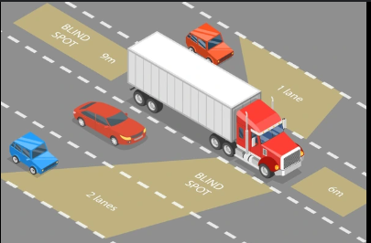
.
.
2
Problem Statement
Road accidents are a major cause of death due to careless overtaking, blind spots, and poor visibility.
Drivers behind trucks often cannot see the road ahead, leading to misjudged overtaking.
Lack of real-time alerts increases chances of accidents on highways and narrow roads.
Most existing safety systems are too expensive or not available in low-cost vehicles.

Slide 8
03
Motivation

Slide 9
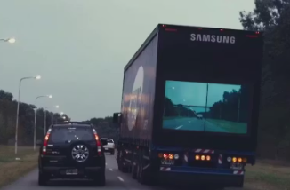
.
.
3
Motivation
Inspired by Samsung’s Safety Truck concept, which uses a front-facing camera on trucks to stream the front view onto a screen placed at the back of the truck. This helps drivers behind the truck see what’s ahead and decide safely when to overtake.

Slide 10
04
Proposed Solution

Slide 11
4
Proposed Solution
To create a low-cost, smart safety system that can be installed on any vehicle using affordable hardware.
Combine with camera, sensors, screen ,LED lights for indicators and real-time alerts to support safe overtaking and accident prevention.
Help reduce accidents and improve road safety for overtaking especially on highways.
Provide a useful tool for drivers by logging data and showing driving behavior.

Slide 12
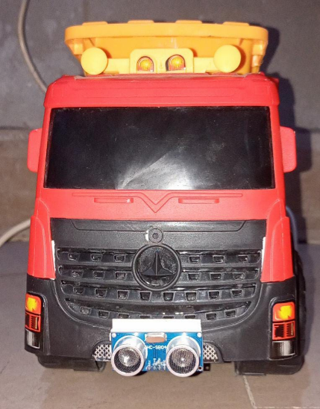
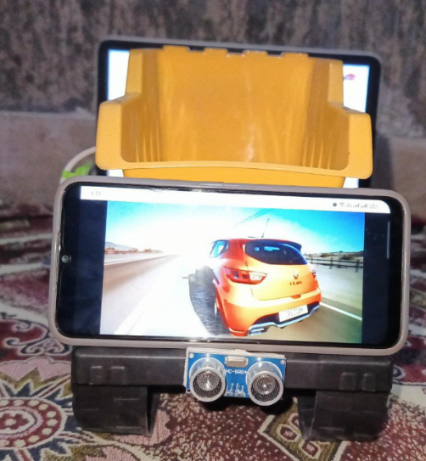
4
Proposed Solution
FRONT VIEW
BACK VIEW

Slide 13
05
Project Objective

Slide 14
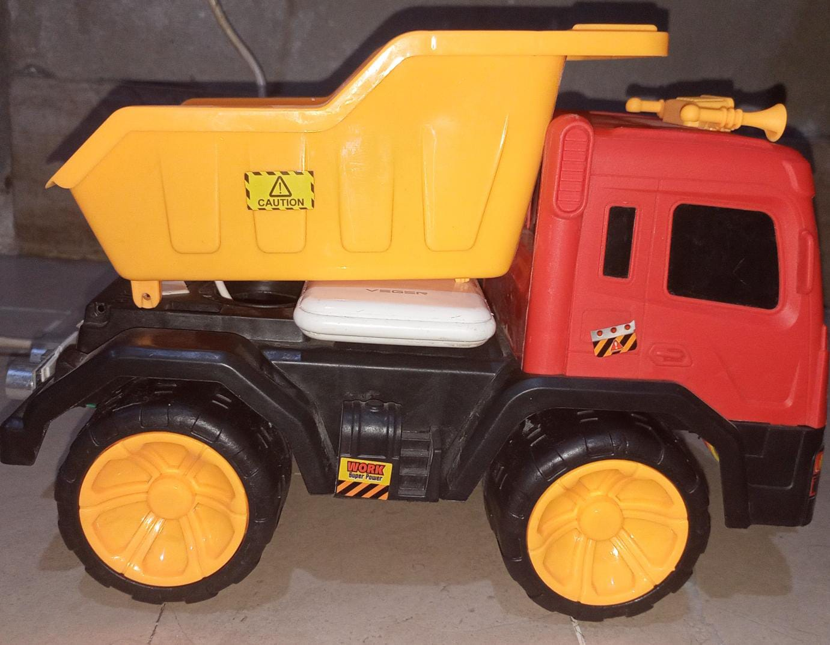
5
Project Objective
Real-time video streaming from a front-facing camera to a rear-mounted display.
Proximity sensors to detect vehicles within a specified range.
Visual collision warnings for vehicles behind.
LED indicators to signal safe (green) or unsafe (red) overtaking conditions.
Display reviewed data on dashboard.
Vehicle counting for data analysis.

Slide 15
06
Tools & Technologies

Slide 16
.
6
Tools & Technologies
Hardware:
Camera, Ultrasonic Sensors, Node MCU, Buzzers, Arduino UNO, LCD(ILI-9486), LED lights
Software:
Python, YOLO 3, OpenCV, Arduino IDE
Techniques:
Image Processing, Model Training, Roboflow

Slide 17
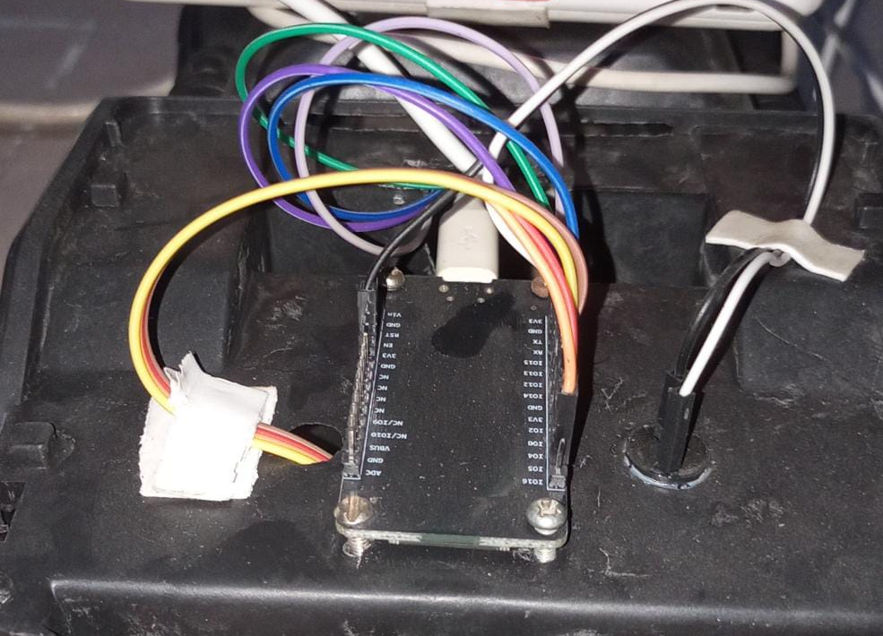
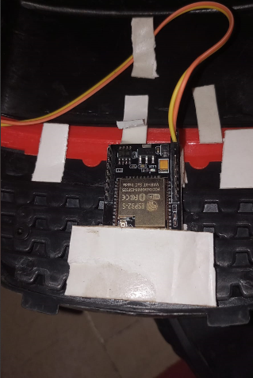
.
6
Tools & Technologies
Node MCU Connects buzzer and ultrasonic sensor (front and back)
ESP 32 Camera Use for streaming over internet.

Slide 18
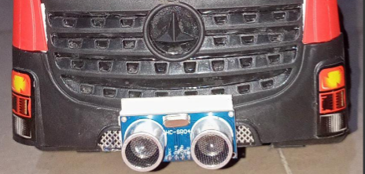
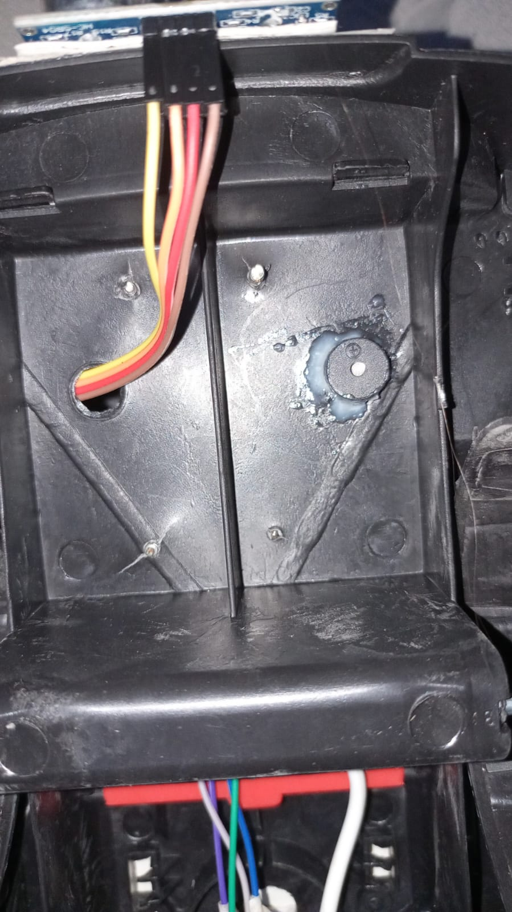
.
6
Tools & Technologies
Front ultrasonic sensor Use to calculate distance.
Buzzer Generate alert if distance is less than 50cm.

Slide 19
07
Similar Applications

Slide 20
7
Similar Applications
MirrorCam System (Mercedes-Benz
Transparent Truck (Samsung)
Mobileye Shield+
Similar: Front camera streaming to rear display.
New: Proximity detection and collision warnings.
Similar: AI and cameras for collision avoidance.
New: Highway-focused overtaking assistance.
Similar: Camera-based visibility improvement.
New: Rear-mounted display for following vehicles.

Slide 21
08
Project Features

Slide 22
8
Project Features
ESP32-CAM captures the front road view and & detects the vehicle.
Arduino Uno controls and manages signals.
8-bit ILI9486 LCD shows the live video stream on the rear of the truck.
Green & Red LED indicators help drivers behind the truck:
🔴 Red LED: Unsafe to overtake (vehicle nearby or blocked view).
🟢 Green LED: Safe to overtake (clear road ahead).
Web dashboard stores and displays driving history and vehicle logs.
Improved hardware wiring ensures stable performance and fewer connection issues.
Testing:
Conduct real-time environment testing using toy cars..
Fine-tune sensor sensitivity and response times.

Slide 23
09
Testing & Validation

Slide 24
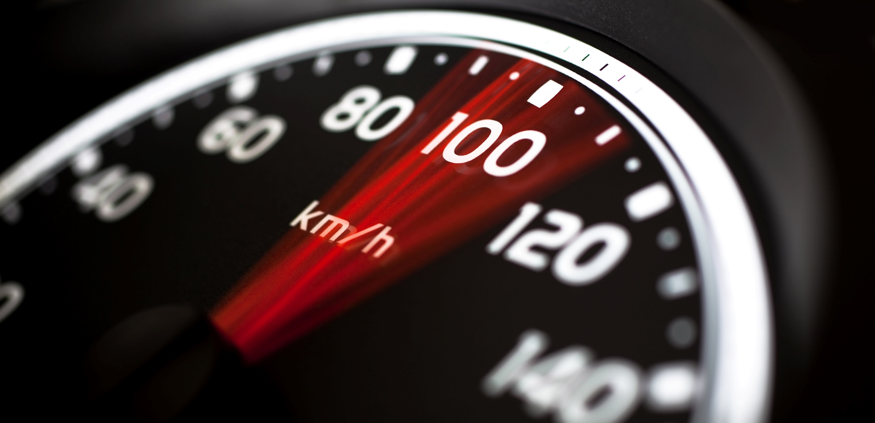
9
Testing & Validation
METRICS:
Accuracy of proximity detection
Reliability of video streaming on LCD display
Responsiveness of the LED warning system
Stability of hardware connections (jumpers, sensors)
Correctness of data logging on the web dashboard
Visibility of green/red LED indicators in different lighting conditions
.

Slide 25

Budget & Scalability
Cost-Effective Components:
Camera, Sensors, Node MCU, Buzzers, Arduino uno, LCD & LED.
Scalability:
Suitable for large-scale adoption in commercial purposes.

Slide 26
10
Work Flow

Slide 27
10
Work Flow
Camera captures front road footage
YOLO detects vehicles in real time
Arduino processes detection results
Ultrasonic sensor (or proximity logic) checks safe distance
Green/Red LED indicate overtaking safety
Video feed displayed on rear LCD screen
Alerts activated for collision risks
Driving data logged and shown on web dashboard

Slide 28
11
Conclusion

Slide 29

11
Conclusion
Vision-Guard enhances highway safety by tackling visibility and proximity challenges. It minimizes blind spots, improves overtaking decisions, and reduces accidents by enabling drivers to see ahead of trucks and issuing timely warnings. By using low-cost components. The system shows how simple components can work together for advanced safety. Despite a few hardware limits, the prototype works well. Vision-Guard combines innovation and affordability to create safer, making roads safer for everyone.

